Slide 1
EXAMPLE 1

Slide 2






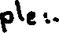
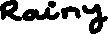






Slide 3





Slide 4
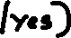
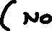
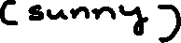
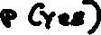
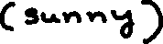
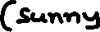
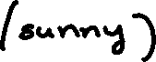
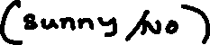
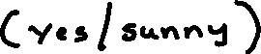
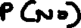

Slide 5
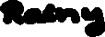

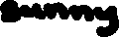










Slide 6
EXAMPLE 2

Slide 7
S. No | Outlook | Temp | Humidity | Windy | Play Tennis
1 | Rainy | Hot | High | False | No
2 | Rainy | Hot | High | True | No
3 | Overcast | Hot | High | False | Yes
4 | Sunny | Mild | High | False | Yes
5 | Sunny | Cool | Normal | False | Yes
6 | Sunny | Cool | Normal | True | No
7 | Overcast | Cool | Normal | True | Yes
8 | Rainy | Mild | High | False | No
9 | Rainy | Cool | Normal | False | Yes
10 | Sunny | Mild | Normal | False | Yes
11 | Rainy | Mild | Normal | True | Yes
12 | Overcast | Mild | High | True | Yes
13 | Overcast | Hot | Normal | False | Yes
14 | Sunny | Mild | High | True | No

Slide 8
today = (Sunny, Hot, Normal, False)

Slide 9
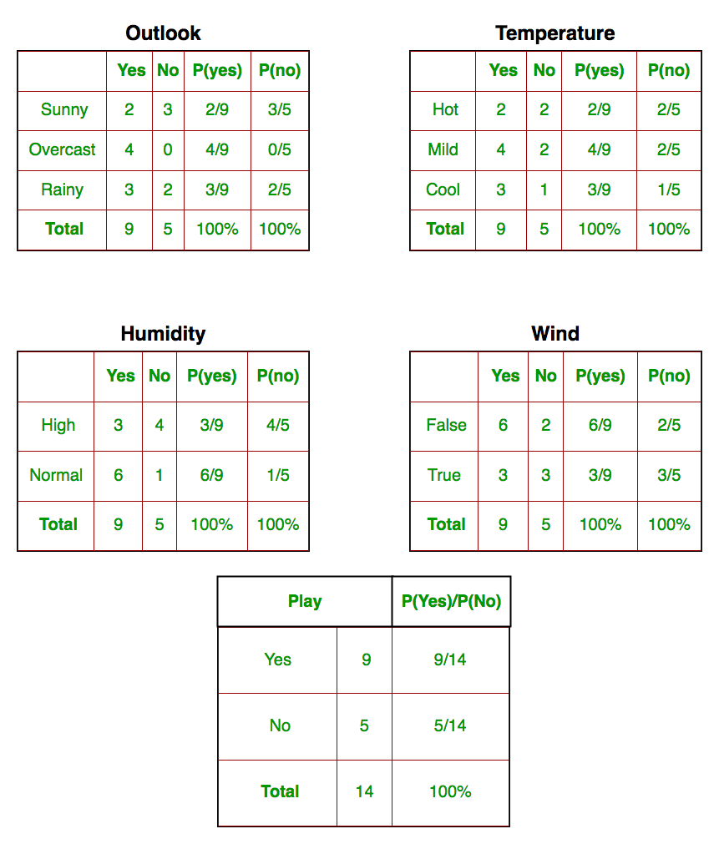

Slide 10
EXAMPLE 3

Slide 11
New Instance: Magazine Promotion = Yes , Watch Promotion = Yes, Life Insurance Promotion = No, Credit Card Insurance = No then Sex = ?
Magazine Promotion | Watch Promotion | Life Insurance Promotion | Credit Card Insurance | Sex
Yes | No | No | No | Male
Yes | Yes | Yes | Yes | Female
No | No | No | No | Male
Yes | Yes | Yes | Yes | Male
Yes | No | Yes | No | Female
No | No | No | No | Female
Yes | Yes | Yes | Yes | Male
No | No | No | No | Male
Yes | No | No | No | Male
Yes | Yes | Yes | No | Female

Slide 12


Slide 13



Slide 14



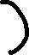

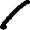

Slide 15
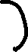


Slide 16
EXAMPLE 4

Slide 17
Example 4
A: attributes
M: mammals
N: non-mammals
P(A|M)P(M) > P(A|N)P(N)
=> Mammals

Slide 18
THANKS

